Slide 1
A Mixed Model for Cross Lingual Opinion Analysis
Lin Gui, Ruifeng Xu, Jun Xu, Li Yuan, Yuanlin Yao, Jiyun Zhou, Shuwei Wang, Qiaoyun Qiu, Ricky Chenug

Slide 2
Content
Introduction
Our approach
The evaluation
Future work

Slide 3
Introduction
opinion analysis technique become a focus topic in natural language processing research
Rule-based/machine learning methods
The bottle neck of machine learning method
The cross-lingual method for opinion analysis
Related work

Slide 4
Our approach
Cross-lingual self-training
Cross-lingual co-training
The mixed model

Slide 5

Cross-lingual self-training
An iterative training process
Classify the raw samples and estimate the classification confidence
Raw samples with high confidence are moved the annotated corpus
Re-trained by using the expanded annotated corpus
$y=\sum_{j= source \& target}{{(1−E}_{j})W_{j}\left(x_{j}\right)}$

Slide 6
Cross-lingual self-training
Target language annotated corpus
MT
Source language annotated corpus
Top K
SVMs
SVMs
Top K
Unlabeled target language corpus
Unlabeled source language corpus
MT

Slide 7
Cross-lingual co-training
similar to cross-lingual transfer self-training
Difference：
In the co-training model, the classification results for a sample in one language and its translation in another language are incorporated for classification in each iteration

Slide 8
Cross-lingual co-training
Target language annotated corpus
MT
Source language annotated corpus
SVMs
Top K
SVMs
Unlabeled target language corpus
Unlabeled source language corpus
MT

Slide 9

The mixed model
The weighting strategy in mixed model：
$y=\sum_{j=s\&t}{\sum_{i=st\&ct}{(1−E_{i:j})W_{i:j}^{k}\left(x_{j}\right)}}$
when y is greater than zero, the sample sentence will be classified as positive, otherwise negative
classifier with a lower error rate is assigned a higher weight in the final voting
expected to combine multiple classifier outputs for a better performance

Slide 10
The evaluation
This dataset consists of the reviews on DVD, Book and Music category
The training data of each category contains 4,000 English annotated documents and 40 Chinese annotated documents
Chinese raw corpus contains 17,814 DVD documents, 47,071 Book documents and 29,677 Music documents.
each category contains 4,000 Chinese documents

Slide 11
The baseline performance
Only use 40 Chinese annotated documents and the machine translation result of 4000 English annotated documents
The classifier: SVM-LIGHT
Feature: lexicon/unigram/bigram
MT system: Baidu fanyi
Segmentation tools: ICTCLA
Lexicon resource: WordNet Affect

Slide 12
The baseline performance
Category | Accuracy
Accuracy_{DVD} | 0.7373
Accuracy_{Book} | 0.7215
Accuracy_{Music} | 0.7423
Accuracy | 0.7337

Slide 13
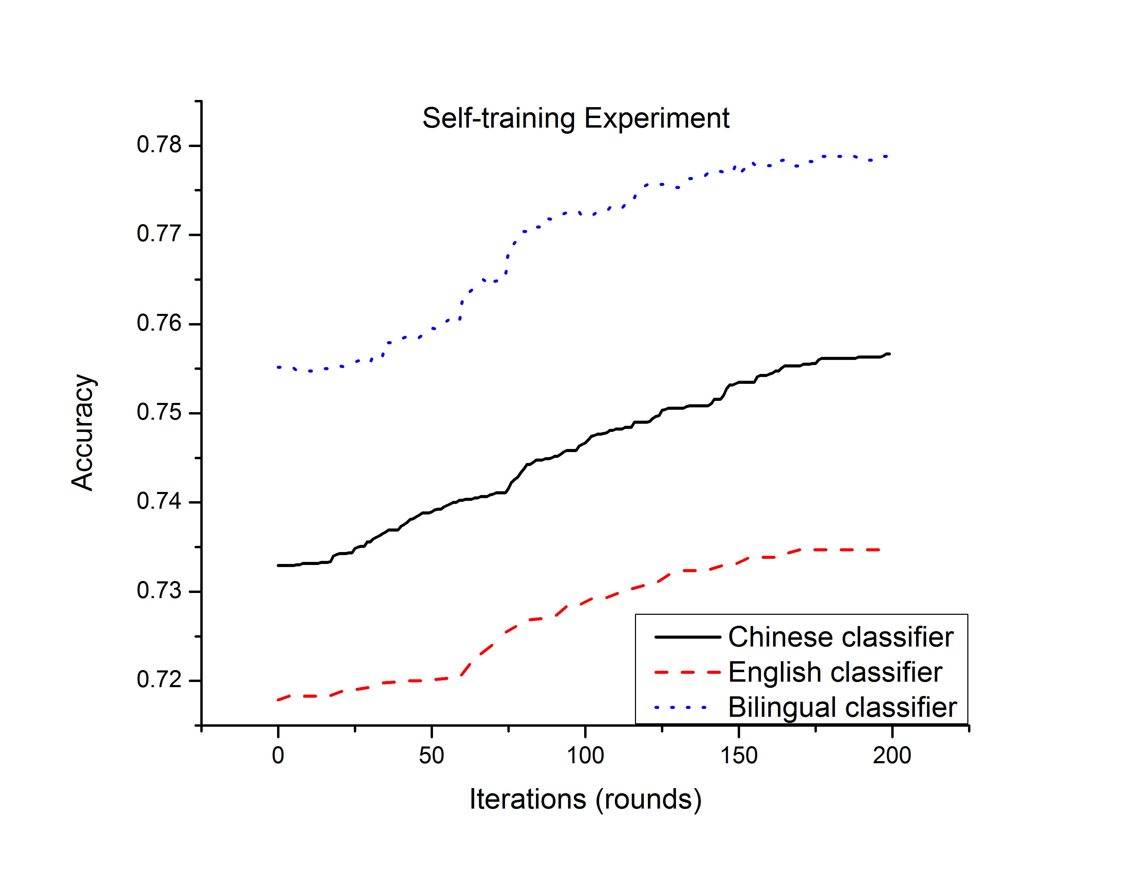
The evaluation of self-training

Slide 14
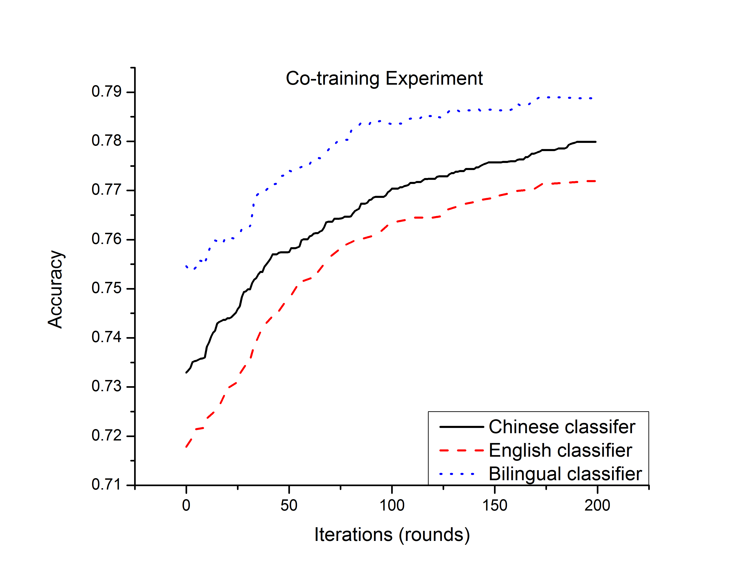
The evaluation of co-training

Slide 15
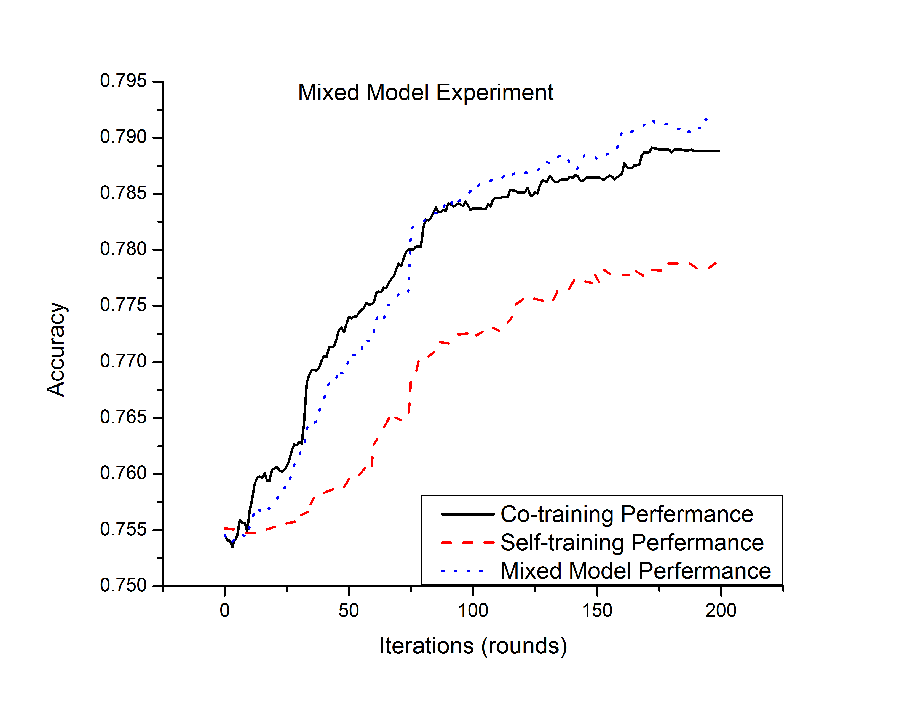
The evaluation of mixed model

Slide 16
The evaluation result
Team | DVD | Music | Book | Accuracy
BISTU | 0.6473 | 0.6605 | 0.5980 | 0.6353
HLT-Hitsz | 0.7773 | 0.7513 | 0.7850 | 0.7712
THUIR-SENTI | 0.7390 | 0.7325 | 0.7423 | 0.7379
SJTUGSLIU | 0.7720 | 0.7453 | 0.7240 | 0.7471
LEO_WHU | 0.7833 | 0.7595 | 0.7700 | 0.7709
Our Approach | 0.7965 | 0.7830 | 0.7870 | 0.7889

Slide 17
Conclusion & future works
This weighted based mixed model achieves the best performance on NLP&CC 2013 CLOA bakeoff dataset
Transfer learning process does not satisfy the independent identical distribution hypothesis

Slide 18
Thanks

