Slide 1
Incorporating Entities in News Topic Modeling
Linmei HU¹, Juanzi LI¹, Zhihui LI², Chao SHAO¹, and Zhixing LI¹
¹ Knowledge Engineering Group, Dept. of Computer Science and Technology, Tsinghua University
² Dept. of Computer Science and Technology ,Beijing Information Science and Technology
Notes:
Hello, everyone. I’m Linmei Hu from Tsinghua University. It’s my pleasure to present our paper titled “Incorporating Entities in News Topic Modeling”. It is a joint work with Juanzi Li, Chao Shao and Zhixing Li from KEG, Tsinghua University and Zhihui Li from Beijing Information Science and Technology University.
大家下午好，我是来自清华大学的胡琳梅。很荣幸在这报告论文“Incorporating entities into news topic modeling”.文章其他作者还有清华大学keg实验室的李娟子，邵超，李智星以及北京信息科学技术大学的李智慧。

Slide 2
Outline
Motivation
Related Work
Approach
Experiment
Conclusion & Future Work
Notes:
This is the outline of my presentation, I will start with the motivation, go through some of the related research, and then introduce our approach as well as the evaluation, finally I summarize our work and list some future directions.
这是报告提纲，motivation， related work， approach， experiment和conclusion and Future work

Slide 3
Motivation
Online news reading has become a popular habit
With the increasingly overwhelming volume of news
articles, it is urgent to organize news to facilitate reading
Named entities paly critical role in conveying semantic information. Why not cluster
news according to entities?
78% of Internet users in China (461 million) read news online[Jun, 2013, CNNIC]
Notes:
Online news reading has become a popular habit.
The rapid development of the Web facilitates people’s information acquiring. More and more people read news online, the number in China had reached 461 million by the end of June this year, about 78% of the Internet users.
With the overwhelming volume of news articles, it is urgent to organize news to facilitate reading
Instead of flooding with large amount of information, people prefer to get an overview of the current news by only reviewing named entities. Thus, we want to cluster news articles according to entities.
（在线新闻阅读已成为一个普遍的习惯，网络的快速发展方便了人们获取信息，越来越多的人在线阅读新闻，今年六月底，中国用户达到46.1千万，占网络用户的78%
随着大量新闻文章的出现，我们急于找到好的组织方式加速新闻的阅读
为了避免迷失在信息爆炸中，人们喜欢通过命名实体大致了解新闻内容，因此，我们想要根据实体来聚类相关的新闻，例如，我们可以把所有和汶川，四川，玉树等实体相关的新闻聚成一类，而清华大学，陈吉宁，温家宝等实体相关新闻聚成一类）

Slide 4
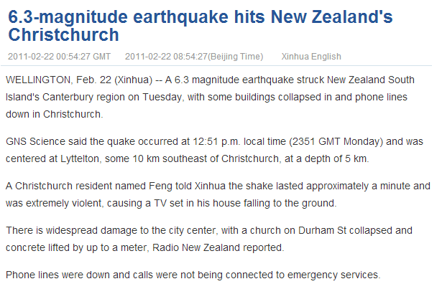
Motivation
What?
When?
Where?
Who?
Named entities which refer to names, locations, time, and organizations play critical roles in conveying news semantics like who, when, where and what etc
Notes:
Named entities which refer to names, locations, time, and organizations play critical roles in conveying news semantics like who, where, when and what etc.
But how can we incorporate entities into news modeling in order to get an efficient view of large online news articles？
命名实体包括人名，地名，时间和组织在表达新闻语义who,where, when and what有重要作用
但是如何把实体信息容纳到新闻建模来组织新闻，促使阅读的高效率？

Slide 5
Related Work
LDA（Latent dirichlet allocation）.
Blei, D.M., Ng, A.Y., Jordan, M.I.
In Journal of Machine Learning Research 3 (2003)
Entity topic models for mining documents associated with entities
Kim, H., Sun, Y., Hockenmaier, J., Han, J.
In: ICDM’12. (2012)
Statistical entity-topic models.
Newman, D., Chemudugunta, C., Smyth, P.
In KDD. (2006)
Notes:
As we mainly work about news modeling in this paper, we review three most related articles all about topic model.
The first is LDA proposed by Blei.
The second work is ETM, entity topic models for mining documents associated with entities.
The last work is CorrLDA2, a statistical entity-topic model presented by Newman.
有一些相关的模型来组织文档。
第一个是blei提出的LDA
第二个工作是ETM，实体话题模型用于挖掘文档以及实体
第三个工作是,CorrLDA2，newman提出的统计实体话题模型

Slide 6
Related Work
The dependency of topic, entity and word
We propose Entity Centered Topic Model (ECTM).
We cluster news articles according to entity topics.
Notes:
We illustrate different dependencies of topic, entity and word with different models as mentioned in related work.
LDA can be extended to detect interaction between entities and topics, but it cannot model the relationship between words and entities.
ETM modeling the generative process of a word given its topic and entity information, but it does not cover relationship among entities.
David Newman proposed entity topic model, called CorrLDA2, modeling word topic as a distribution over entity topics. The model can cluster entities and explicitly show word topic related entity topics, while experimental results show unreasonable clustering of entities.
We propose entity centered topic model, ECTM based on CorrLDA2 while differs in the generative order of words and entities. Therefore, the order of entity topic and word topic is reverse.
We cluster news articles according to entity topics. Our model gets higher quality of entity topics, also called entity clusters.
这个图我们展示了相关工作中的三个模型的不同的组织模式。LDA可以扩展得到话题和实体的关系，但是没有实体之间的关系以及实体和词之间的关系。
ETM模拟词的生成过程是先给定一个实体信息，再生成topic. 这个模型能得到实体和词之间的关系，但是没有实体与实体间的关系。
CorrLDA2模拟词话题在实体话题上有一个distribution，可以对实体进行聚类成实体话题，同时清晰展示了词话题相关的实体话题。但是实验结果证明实体话题的效果并不是很好，也就是对实体聚类的效果不是很好。
我们提出了Entity Centered Topic Model,ECTM 基于CorrLDA2 但是生成词和实体的顺序相反，得到实体话题在词话题上有一个分布。
我们根据实体话题对新闻聚类，得到更高质量的实体话题，或者说实体聚类结果。

Slide 7
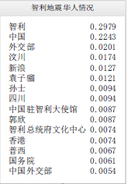
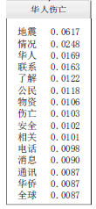
Our work
Entity topic: A multinomial distribution over entities, represented by top 15 entities.
Word topic: A multinomial distribution over words, represented by top 15 words.
We separately generate entities and words.
We assume when writing a news article, named entities are determined first, which implies a set of entity topics. Then there goes the word topic given the entity topic which has a multinomial distribution over word topics.
Entity Topic
Word Topic
Notes:
Before going into the detail of our model, we first introduce some basic concepts and facts.
Entity topic is A multinomial distribution over entities, represented by top 15 entities.
Word topic denotes A multinomial distribution over words, represented by top 15 words.
We separately generate entities and words.
We assume when writing a news article, named entities are determined first, which implies a set of entity topics. Then there goes the word topic given the entity topic which has a multinomial distribution over word topics.
在介绍模型前，我们先介绍一些概念和假设。
实体话题是一个在实体上的多项分布，用top 15个实体表示
词话题是一个在词上的多项分布，用top 15个词表示
对于一篇文章，我们分别生成词和实体
我们假设在写一篇新闻的时候，命名实体先生成，形成了一组实体话题，然后根据他们相应的出现频率，我们先sample一个实体话题，再根据实体话题在词话题上的多项分布，sample一个词话题，最后再生成词

Slide 8
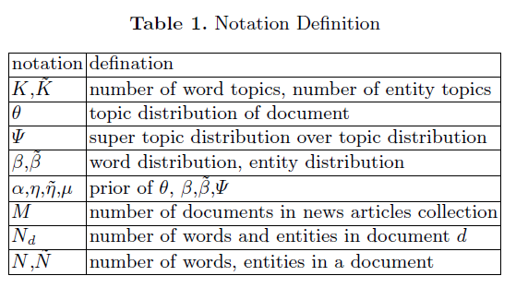
ECTM(Entity Centered Topic Model)
Denotations
Notes:
Here presents the notation definition. Alpha, miu, eta, eta tilde are priors for topic distribution theta, word topic to entity topic distribution kesai, word distribution beta and entity distribution beta tilde respectively.
entity e and word w are observed data.
K and K tilde are number of word topics and number of entity topics respectively.
N and N tilde are number of words and number of entities respectively.
这里给了一些符号定义，alpha，miu，eta和eta波浪线是theta，kesai，beta，beta波浪线的先验
Theta是文档在话题上的分布；kesai是实体话题到词话题上的分布；beta是词话题到词上的分布，beta波浪线是实体话题到实体的分布
实体e和词w是观测到的数据
K和K波浪线分别是模型中设定的词话题数和实体话题数
N和N波浪线分别是文档的词的数量和实体数量

Slide 9
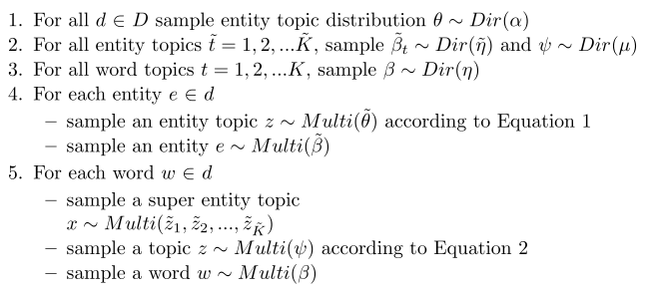
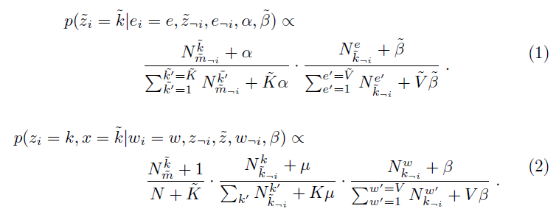
ECTM(Entity Centered Topic Model)
[1]
[1]Heinrich G. Parameter estimation for text analysis[J]. Web: http://www. arbylon. net/publications/text-est. pdf, 2005.
Notes:
The graph model is shown in the left. It is like a combination of two LDA models. In the left is a process of generating entites where it is the same as LDA, while in the right is the process of sampling words. It is different from LDA in that when sampling the topic, the super entity topic should be first sampled from a multinomial distribution, then according to the entity topic, a word topic is sampled.
The equation is also similar to the process of LDA, which can be referred to the paper titled “Parameter estimation for text analysis”[J].
左边就是我们的模型图，我们很容易看出它就像两个LDA模型结合在一起，左边是实体生成过程，和LDA完全一样，先sample一个实体话题根据参数theta，然后sample 一个实体，根据已经sample的实体话题以及实体话题在实体上的分布beta波浪线。右边是词的生成过程，和LDA不同的是在sample一个词的时候需要先sample一个实体话题，根据已有的实体话题频率。
我们采用gibbs sampling求解模型，相应的sample的公式和LDA的推导过程一样，可以参考论文“Parameter estimation for text analysis”

Slide 10
Data Set
Sources (Chinese: Sina!)
Dataset1: Chile Earthquake Event
Dataset2: National news
Dataset3: Three events of different topics, including Qinghai Earthquake, Two Sessions in 2013 and Tsinghua University
Table 2. Statistics of Datasets
 | Articles | Words | Entities
Dataset1 | 632 | 5,482 | 1,657
Dataset2 | 700 | 15,862 | 5,357
Dataset3 | 1,800 | 19,597 | 10,981
Notes:
Our experiments are conducted on three datasets from sina news.
Dataset1 contains articles about Chile Earthquake Event where entities all belong to the event.
Dataset2 is about various kinds of national news with entities decentralized.
Dataset3 is a collection about three events including Qinghai Earthquake, Two Sessions in 2013 and Tsinghua University. The entities are centralized within a same event while decentralized between different events.
We want to test the model on datasets with different entity properties.
Table 2 summarizes some statistics about the datasets.
我们在三个数据集上做的实验。
第一个是智利地震事件，所有文章都与该事件有关，实体都与该事件相关
第二个是国内各种类别的新闻，实体相对分散
第三个是包含三个事件的数据集，实体在事件内集中，不同事件相对分散

Slide 11
Experimental Setup
We evaluate ECTM’s performance by measure of perplexity taking LDA and CorrLDA2 as baselines.
To further analyze the entity topics generated using different models, we measure with average entropy of entity topics and average sKL of all pairs of entity topics.
Finally, we analyze and compare overall results of different models.
Notes:
We carry on three experiments with the datasets.
First, We evaluate ECTM’s performance by measure of perplexity taking LDA and CorrLDA2 as baselines.
Second, To further analyze the entity topics generated using different models, we measure with average entropy of entity topics and average sKL of all pairs of entity topics.
Finally, we analyze and compare overall results of different models.
我们在数据集上做了三个实验
第一，我们将LDA和CorrLDA2作为baseline，通过perplexity评价了ECTM
第二，为了进一步分析不同模型生成的实体话题，我们通过信息熵和KL距离来评价实体话题，也就是实体聚类结果
最后，我们分析比较了不同模型的整体结果。

Slide 12
Perplexity
Often one tries to model an unknown probability distribution p, based on a training sample that was drawn from p.
Given a proposed probability model q, one may evaluate q by asking how well it predicts a separate test sample x₁, x₂, ..., x_{N} which are also drawn from p. The perplexity of the model q is defined as
Better models q of the unknown distribution p will tend to assign higher probabilities q(x_{i}) to the test events. Thus, if they have lower perplexity, they are less surprised by the test sample.
Notes:
Here, we introduce the definition of perplexity which comes form wikipedia.
这里我们介绍了perplexity的定义，来自维基百科的解释。
通常我们会模拟一个未知的概率分布p，基于一个由p生成的训练数据。
给定一个概率模型q，我们可以通过判断它能多好的预测一个单独的测试样本集，x1到xn，也是由p生成。模型q的perplexity的定义如下。
好的模型q会倾向给予测试数据较大的概率，perplexity低，我们对于测试数据就会觉得正常。

Slide 13
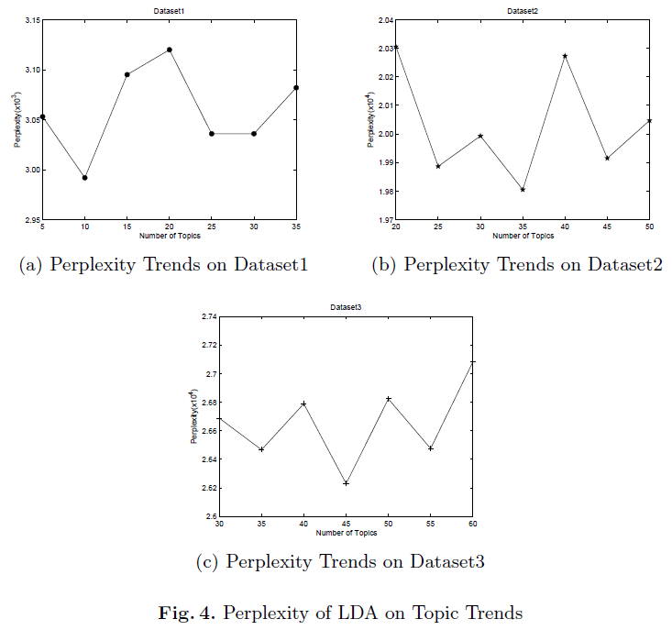
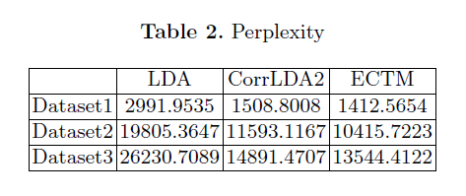
Perplexity
We first determine the topic number by applying LDA on three datasets and observing the trend of perplexity on topic numbers.
Then we test perplexity of topic models based on same topic number. ECTM shows lowest perplexity on three datasets. Perplexity grows with the number of words or entities.
Notes:
1. We first determine the topic number by applying LDA on three datasets and observing the trend of perplexity on topic numbers. Shown as the three curves. We determine the value with lowest perplexity as the most appropriate topic number.
2. Then we test perplexity of topic models based on same topic number. It can be apparently seen that our proposed model has lowest perplexity, which shows ECTM performs well. The reason behind that may be it is more reasonable for news article to write with entities going first.
我们首先通过LDA在三个数据集上不同topic数目的测试，确定最合适的topic数目
接着，我们测试不同模型在同样的topic number下的perplexity。 我们可以从表格中看到ECTM的perplexity最低。
并且，对于同一个数据集，我们发现perplexity随着数据集的词或者实体的数目增大而增大
Besides, we find, for a same model, perplexity grows with the size of dataset, namely the size of entities or words.

Slide 14
Entity Clustering
1. Definition of Entropy and sKL(symmetrical Kullback–Leibler divergence)
2. The values with underlines show our ECTM better in entity clustering with lower entropy and larger sKL
Notes:
Different form LDA and ETM, both CorrLDA2 and our ECTM cluster entities as entity topic. We compare the performance of the entity cluster by entropy and SKL. SKL is short for Symmetrical Kullback Leibler Divergence which is based on KL divergence. As we all know, lower entropy and higher sKL means better clustering of entities with small distance within same entity topic but large distance between different entity topics.
Since entity topic is a distribution of entities. We set a probability threshold for each entity topic, we consider entity whose probability is larger than threshold belonging to the entity topic. The table presents average entropy of all entity topics under different thresholds and average sKL for all topic pairs.
The values with underlines show our ECTM better in entity clustering with lower entropy and larger sKL.
与LDA和ETM不一样，CorrLDA2和ECTM都会对实体聚类，产生实体话题，我们想通过信息熵和KL距离来比较实体聚类效果，又由于KL距离不对称，因此我们采用变形，对称KL距离，公式定义是这样。我们知道熵越小说明类内距离越小，而KL距离越大说明类间距离越大，聚类结果越好。
这些带有下划线的值说明了我们的模型聚类结果更好。
最后计算结果如表中所示。
由于实体话题是在所有实体上的概率分布，我们设定了不同概率阈值，大于阈值的实体才被认为属于该实体话题。

Slide 15
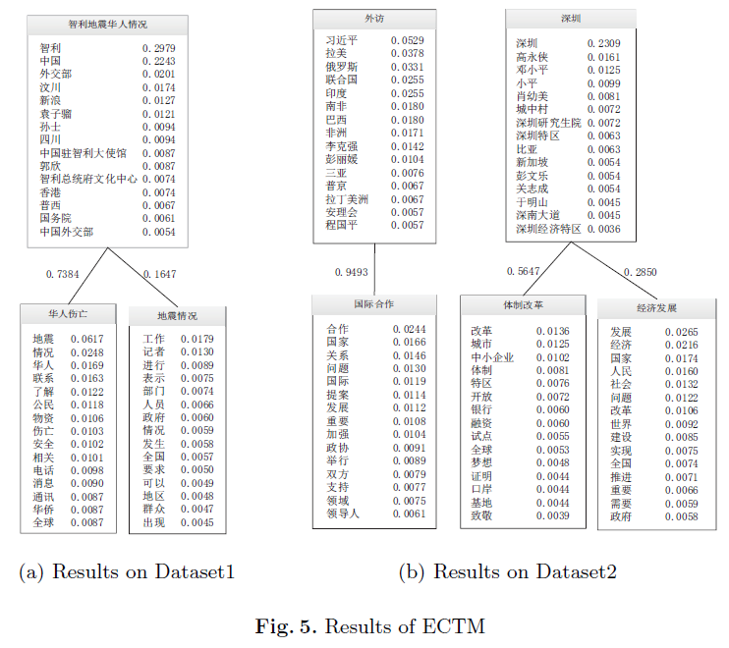
Results—ECTM good at news organization
Entity Topic
Word Topic
Notes:
This figure shows the ability of ECTM to organize news articles according to entity topics, where entity topic is a distribution
over word topics. It is part of modeling results on Dataset1 and Dataset2. Both entity topics and word topics are represented with top 15 terms.
In Dataset1, we can see ”Chile智利”, ”China中国”, ” Ministry of Foreign Affairs外交部” these entities in the entity topic. We can judge the entity topic is about both China and Chile Earthquake.
As expected, the entity topic is 73 percent talking about Chinese people situation in earthquake and 16 percent talking about Chile earthquake, which are shown on the edges. The top 15 words in a topic is listed below the topic label. It is not surprising that we see ”Chinese华人” in the word topic under the entity topic with many entities such as ”China中国”, ” Ministry of Foreign Affairs外交部”, ” The Chinese embassy in Chile中国驻智利使馆.
In dataset2, the entity topic of ”visit外访” includes entities like ”习近平”, ” Latin America拉美” and it is almost only related to the word topic ”International cooperation国际合作”.However, the entity topic of ”深圳” is almost 60% about ” system reform 体制改革” and 30% about ”ecomomic development经济发展” as shown in the figure. From those results, ECTM shows its effectiveness in clustering entities and mine entities-related word topics.
这张图展示了ECTM对新闻按照实体话题的聚类，实体话题下有相关的词话题。对于深圳这个实体话题，我们可以看到它60%与体制改革话题相关，30%与经济发展相关。
这些数据集展现了ECTM能够有效的用于挖掘新闻中实体话题与词话题之间的关系以及实体的聚类
数据集1智利地震事件中我们可以看到包含中国，智利，外交部等实体的实体话题，我们猜测一定是华人在智利地震中的情况。确实如此，我们看到这个话题73%关于华人伤亡，16%与记者工作情况相关。与该实体话题相关的词话题中，我们可以看到华人等词。它基本上只和国际合作这个话题相关，
数据集二中，外访这个实体话题下包含了习近平，拉美等实体。

Slide 16
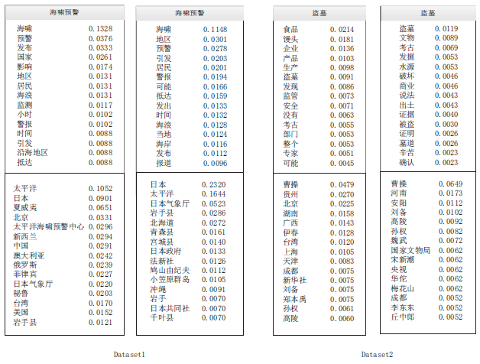
Results—CorrLDA2 VS ECTM(√)
Word Topic
Entity Topic
Notes:
We briefly compare ECTM’s experimental results on Dataset1 and Dataset2 with CorrLDA2. The left is result of CorrLDA2 and the right is result of ECTM where result is presented with word topics above of most related entity topic.
We choose almost the same word topic and pick up corresponding closely related entity topic.
We can see that ECTM clusters entities which are closely related to ”Japan日本”, while corrLDA2 clusters all countries related with ” tsunami warning海啸预警” on Dataset1. For Dataset2, the results of CorrLDA2 are worse. For one side, as ”曹操” should be related with ”An’Yang Henan河南安阳” where he was buried, while the entities under the entity topic. are not as relevant as those generated by ECTM.
For another side, the words included in the word topic, ”grave-robbing 盗墓” are also not accurate by the reason of some unrelated words such as ”food食品”, ”safety安全” and so on.
我们简单比较了我们的模型ECTM和CorrLDA2在数据集1和数据集2上的效果,左侧是CorrLDA2的结果，右边是ECTM的实验结果。可以看到在数据集1上，对于同样的一个海峡预警的词话题，CorrLDA2的相关实体话题中的实体比较分散，包含各个国家，然而ECTM的结果都是日本相关的地方。
数据集二中，我们比较了对于词话题盗墓下的实体话题，我们发现CorrLDA2把很多地名聚到一起，但很多不相关，因为曹操的墓在河南安阳，而我们ECTM的结果非常相关，地名正确还有一些和曹操相关的人，如刘备，孙权等
更糟糕的是，CorrLDA2的词话题的词也比较乱，出现许多如食品，安全等不相关的词。

Slide 17
Conclusion
We propose an entity-centered topic model, ECTM to model generation of news articles by generating entities first, then words.
We give evidence that ECTM is better in clustering entities than CorrLDA2 by evaluation of average entropy and sKL.
Experimental results prove the effectiveness of ECTM.
Notes:
Now, we draw conclusions.
现在，我们总结一下
我们提出了一个实体话题模型，ECTM模拟文档的生成过程是先生成实体，然后生成词
我们证明了ECTM有更好的实体聚类效果
实验证明了ECTM在新闻聚类上的效果

Slide 18
Future Work
Event Clustering: Cluster news articles according to a specific event.
Develop hierarchical entity topic models to mine correlation between topics and correlation between topic and entities.
Develop dynamic entity topic model: Taking time into consideration
Notes:
Finally, we give some future directions of our work.
最后我们给出将来的一些方向：第一是事件聚类，将大量的新闻按事件进行聚类，因为同一事件的实体关系紧密
第二是建立层次实体话题模型，同时展现了话题与实体的关系以及话题与话题之间的关系
最后是建立时序的实体话题模型，考虑时间因素。

Slide 19
Thanks!

