Slide 1
A Unified Framework for Emotional Elements Extraction based on Finite State Matching Machine
Yunzhi Tan, Yongfeng Zhang, Min Zhang, Yiqun Liu, Shaoping Ma
Tsinghua University
cloudcompute09@gmail.com

Slide 2
Outline
Motivation
The Unified Framework based on Finite State Matching Machine
Evaluation
Conclusion and Future Work

Slide 3
Part 1: Motivation
A Unified Framework for Emotional Elements Extraction based on Finite State Matching Machine

Slide 4
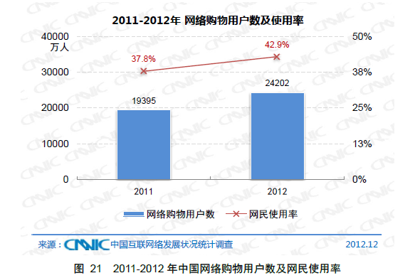
Background
With the rapid development of the Internet, E-commerce is becoming an increasingly popular network application
Notes:
4千8百多万
24.8%

Slide 5
Motivation
A lot of work on high-quality emotional elements(feature, opinion, polarity) extraction
String matching method (baseline)
Adjacent method / Window-based method [Hu 2004, Wang 2008]
Syntax-based method [Popescu 2005, Qiu 2009]
Sequence labeling method [Li 2010, Ma 2010]
Many difficulties
Low accuracy
亮度好价格也低→亮度|好&价格|低&亮度|低&价格|好
High redundancy
功能非常强大→功能|强大&功能|强
Dealing with negative words difficultly
颜色鲜艳但是音效不是很好→颜色|鲜艳 & 音效|好
Poor scalability

Slide 6
Part 2 : The Unified Framework based on Finite State Matching Machine
A Unified Framework for Emotional Elements Extraction based on Finite State Matching Machine

Slide 7
Overview Of Our Unified Framework
Three steps for emotional elements extraction
Matching, Extracting and Filtering
Step 1 : Matching
Review →list of feature words, opinion words, negative adverbs
Step 2 : Extracting
Extracting (feature, opinion) pairs
according to the context and the sentiment lexicon
using a specific finite state machine
Determine sentiment polarity of each feature-opinion pair
Step 3 : Filtering
Rule-based filtering of (feature, opinion) pairs

Slide 8
Step 1: Emotional Elements Matching
Review→list of feature words, opinion words, negative adverbs
颜色鲜艳但是音效不是很好→[颜色，鲜艳，音效，不是，好]
Max-Matching Principle
Choose the longest feature words and longest opinion words
if multiple feature or opinion words can be extracted
Negative Adverbs Processing
Negative Adverbs List
{不是，没有，不够，不能，不……}
Whitelist of Negative Adverbs Words
{不是一般，差不多，不论，不愧……}

Slide 9
Step 2: Emotional Elements Extraction
Take advantage of context to
judge whether a (feature, opinion) pair is correct,
judge whether an opinion word is modified by a negative adverb word
Tow assumptions
Negative adverbs only occur in the front of opinion words or other correct negative adverbs
质量不是很好 and 价格不得不说很公道
A Customer publish a review in the same order (either feature-words occur before opinion-words or the opposite)
价格实惠画面也很清楚 vs 价格实惠且有清晰的画面

Slide 10
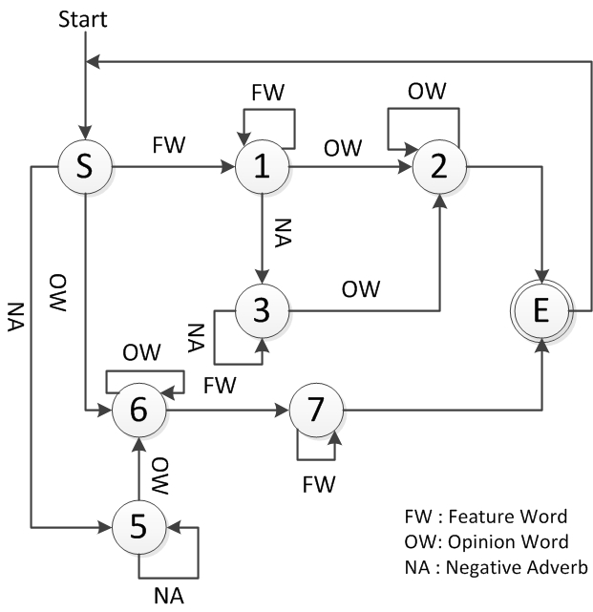
Step 2: Emotional Elements Extraction
Extraction processing based on a finite state machine
Using the list from step 1, the machine transforms its states according to the nature of words in the list.
For instance:
颜色鲜艳但是音效不是很好S→1→ 2→E→1→3→2→E
时尚大方的外观 S→6→6→7→E
不合理的价格 S→5→6→7→E

Slide 11
Step 3: Emotional Elements Filtering
Some errors after step 1 and step 2
京东的售后服务真的很棒→售后服务|真 & 售后服务|棒
一般来说这个品牌兼容性很不错→兼容性|一般
(feature, opinion) pair filtering
Order of feature word and opinion word
Length of opinion words
Distance between feature words and opinion words
Probability that a feature word and an opinion word is a pair

Slide 12
The Unified Framework based on Finite State Matching Machine
Advantages
High extraction accuracy
Low extraction redundancy
Good negative adverbs processing
High scalability

Slide 13
Part 3 : Evaluation
A Unified Framework for Emotional Elements Extraction based on Finite State Matching Machine

Slide 14
Data Preparation
65549 reviews from www.taobao.com and www.jd.com
340 television products
80% reviews: sentiment lexicon construction (feature, opinion, polarity) tuples
20% reviews: evaluation
For each (feature, opinion) pair and its sentiment polarity, we mark it with:
M=1, P=1: both (feature, opinion) pair matching and polarity labeling are correct
M=1, P=0: the (feature, opinion) pair matching is correct, but the polarity is wrong labeled
M=0: the (feature, opinion) pair matching is incorrect

Slide 15
Accuracy of Emotional Elements Extraction
TSM (Traditional String Matching)
Extract all the feature-opinion pairs that occur in both the sentiment lexicon and the reviews
FSMM (Finite State Matching Machine)
Our framework excludes the third step -- (feature, opinion) pair filtering
TUF (The Unified Framework)
Our final unified framework include the all three steps

Slide 16
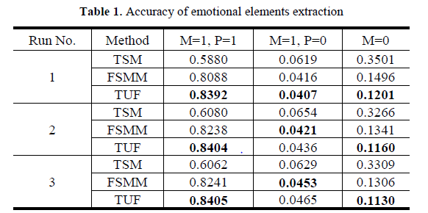
Accuracy of Emotional Elements Extraction
We run three experiments. The experiment results are as follows
+23.4% at most
-2.3% at most
-23% at most

Slide 17
Redundancy Reduction
Extraction redundancy
功能强大→功能|强大 & 功能|强 & 功能|大
亮度好价格也很低→亮度|好 & 价格|低 & 价格|好 & 亮度|低
Redundancy Reduction Rate
Experiment Results

Slide 18
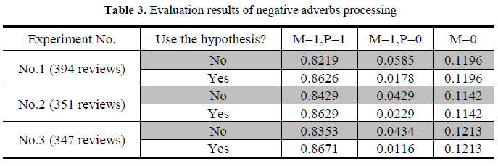
Evaluation of Negative Adverbs Processing
# of polarity changed (feature, opinion) pairs: 2290
Accuracy: 88.6%
The polarities of entries in the sentiment lexicon are all correct?
Hypothesize the polarities of all entries are right

Slide 19
Part 4 : Conclusion and Future Work
A Unified Framework for Emotional Elements Extraction based on Finite State Matching Machine

Slide 20
Conclusion and Future Work
Conclusion
Proposed a unified framework based on finite state matching machine for emotional elements extraction
Achieve higher accuracy(+24%), lower redundancy(-34.5%)
Integrate negative adverbs processing naturally
Better scalability
Future Work
Introduce adverb of degree, comparatives
Introduce semantic information

Slide 21
Thanks!

